Slide 1
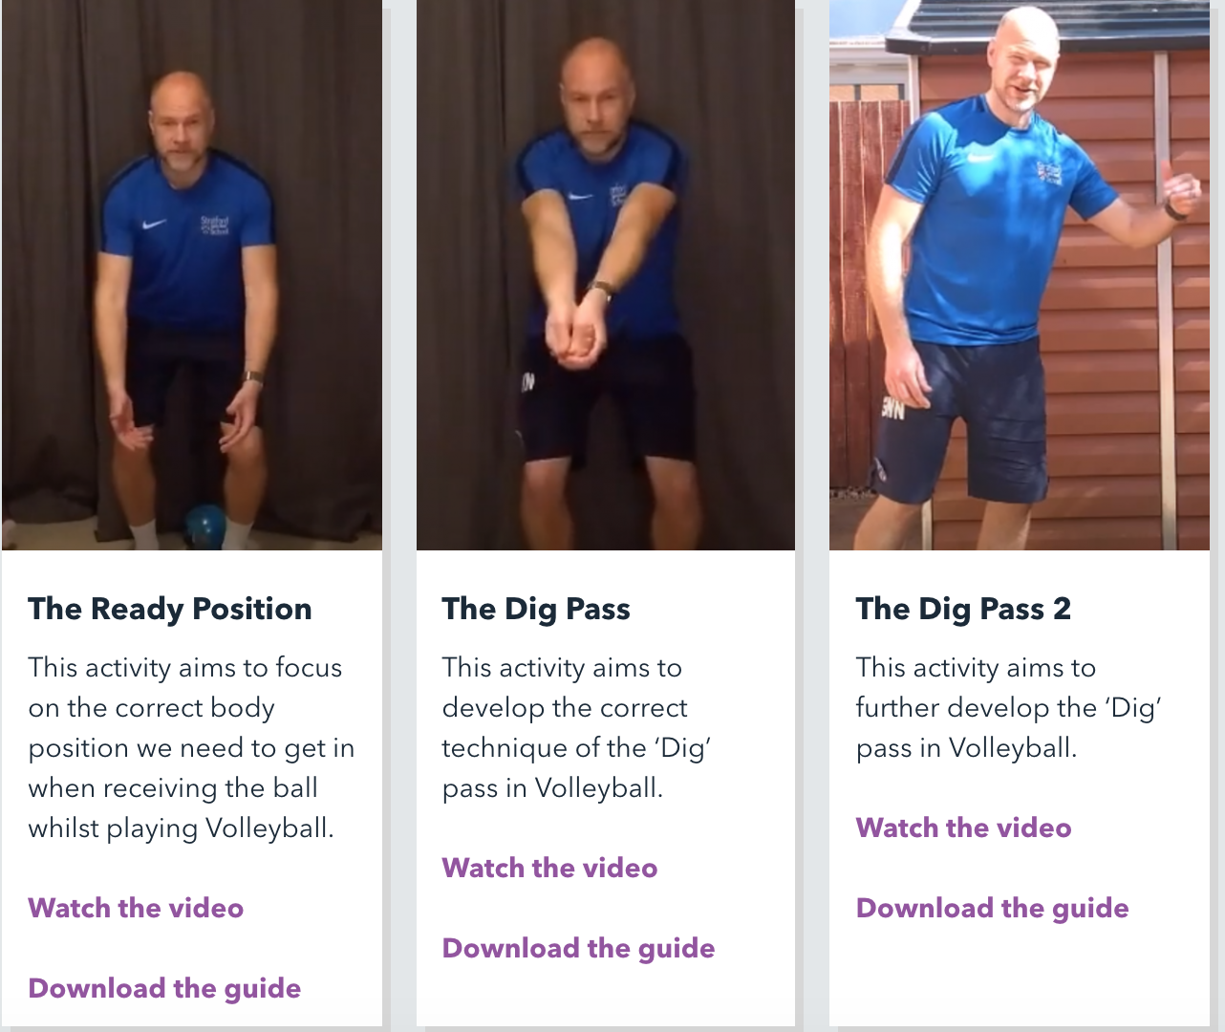
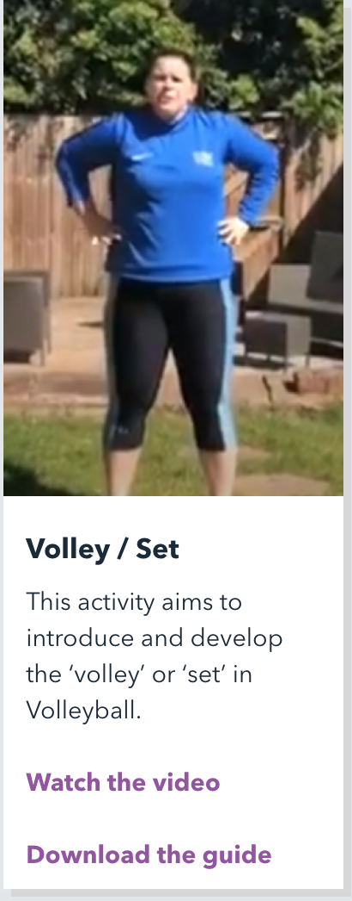

Volleyball At Home
Todays lesson will focus on two key skills of Volleyball that you can complete at home. You will need either a ball or an alternative such as a pillow.
We will be looking at:
The Dig Pass
The Set Shot
In order to complete todays lesson you will need to access the link below and find the title ‘Volleyball’ in the KS3 section there you will find four videos that will explain the different activities for you - simply follow along at home:
https://www.youthsporttrust.org/free-home-learning-resources-secondary
CHALLENGE:
After you have watched a completed all four of the videos it is time for a competitive challenge. Using the dig pass I want you to see how many times you can rally your object either against the wall (if you have a ball) or with a partner, award yourself a medal depending on how many you completed:
10 or more
Between 5-10
Between 2-5

